Slide 1
ARDUINO BASED ECG MONITORING
HEALTH CARE SYSTEM

Slide 2
Guided by :
Project submitted by :
R.KISHORE - 221005032
R.NAVANEEDHA KRISHNAN - 221005042
M.SALMON FAROSE - 221005051
Prof M.CHANDRASEKHARAN
SASTRA DEEMED TO BE UNIVERSITY
SRINIVASA RAMANUJAM CENTER
KUMBAKONAM.

Slide 3
INTRODUCTION:
Surviving sudden cardiac arrests is one of the major challenge to the medical field today.Sudden cardiac arrests kills about 1000 peoples a day more than other diseases. Monitoring ECG signal at initial stage becomes the first step in preventing sudden cardiac arrest.This project is hence proposed to monitor the ECG rate

Slide 4
HARDWARE REQUIREMENTS:
Arduino Uno/Mega/Nano
ECG Module (AD8232)
ECG Electrodes - 3 pieces
ECG Electrode Connector -3.5 mm
Power supply
Connecting Wires

Slide 5
ABSTRACT:
ECG MONITORING USING ARDUINO HELPS IN MONITORING HEARTBEAT RATE VERY ACCURATELY AND ANYWHERE.IT ALSO HELPS IN PROVIDING NECESSARY FIRST AID FOR THE PATIENT IN AMBULANCE BEFORE REACHING THE HOSPITAL.THIS BEING VERY ECONOMIC HELPS IN SAVING LIVES.

Slide 6
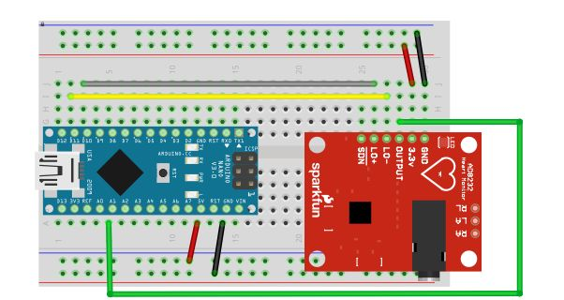
CIRCUIT DIAGRAM:

Slide 7
CIRCUIT CONNECTIONS:
Arduino 3.3V → 3.3V Pin
Arduino Pin 10 → L0+
Arduino Pin 11 → L0-
Arduino Analog1(A1) → O/P
Arduino Gnd → Gnd

Slide 8

PROGRAM USED:

Slide 9
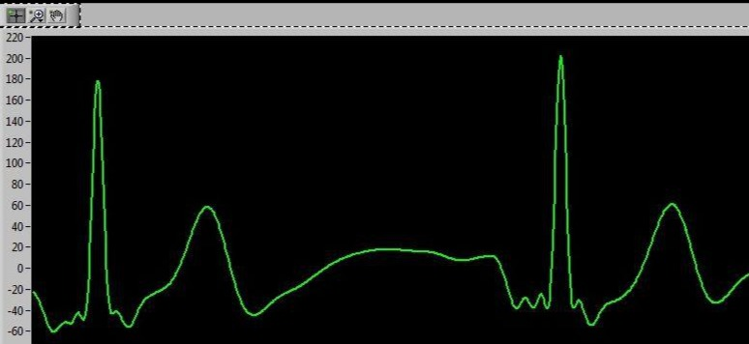
OUTPUT:
Three probes hasbeen used to take the output

Slide 10
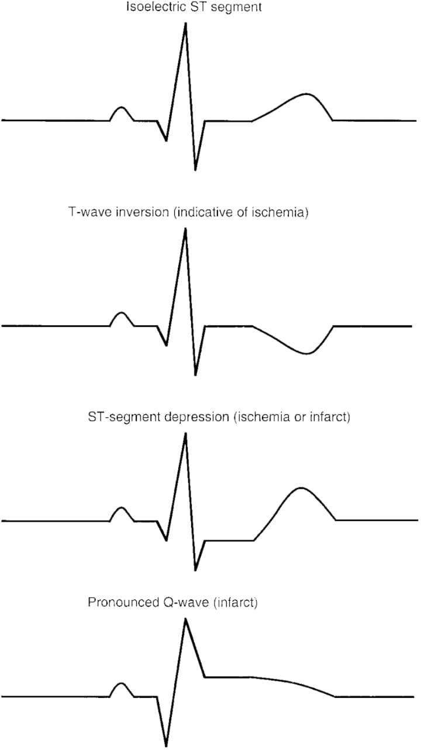
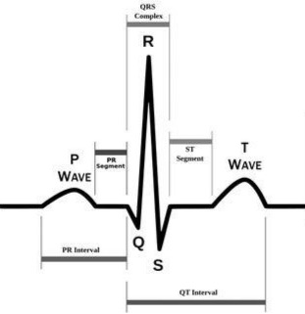
ECG SIGNAL PARAMETERS:

Slide 11
REFERENCE:
Muhammad Wildan Gifari ; Hasballah Zakaria ; Richard Mengko: Design of ECG Homecare: 12-lead ECG acquisition using single channel ECG device developed on AD8232 analog front end, The 5th International Conference on ElectricalEngineeringand Informatics2015August10-11,2015,Baliindonesia,978-1-4673-7319-7/15/$31.00 ©2015 IEEE, pp 371-376.

Slide 12
ADVANTAGES:
Data can be uploaded or directly sent to the doctors by using IOT Technology .
By using more electrodes measurement can be more accurate

Slide 13
FUTURE IMPLEMENTATION:
This ECG Monitoring module can be installed in all ambulances helping doctors in live monitoring of patient's heart beat.Being economical than the normal ECG monitor it is also seen to be accurate

Slide 14
CONCLUSION:
In this project aims at initial prototype development for wireless transmission of ECG signals. It is evident that designing such a system will help in early detection of abnormal conditions of cardiovascular diseases and prevention of its serious consequences.

